Slide 1
Statistic essentials

Slide 2
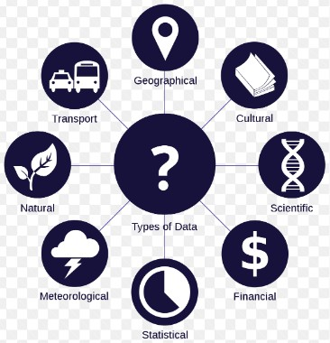
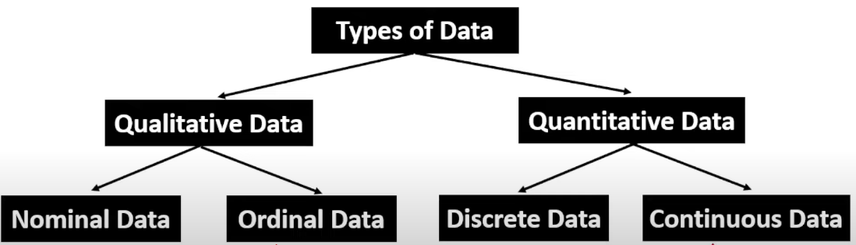
DATA
Types:
Qualitative
Data which is observed subjectively
Quantitative
Which can number
Types
Discrete
measure according to the
Continuous

Slide 3
DATA
Levels:
Nominal(Qualitative)
Data measure according to words, letter, symbol etc.
Ordinal(Qualitative)
Data placing in an order according to their weight
Interval(Quantitative)
Data ordering on the basis of a interval.
Ratio(Quantitative)
Same as interval excluding it don't consider zero value.

Slide 4
DATA
Random Variable:
A function whose every outcome is a new value
Discrete(tossing a coin)
Continuous(floating interest rate)
Probability
It is the chance of happening some event.
Discrete probability(list possible value of random number like 1,2,3,4)
Continuous probability(listing possible value of continuous value)

Slide 5

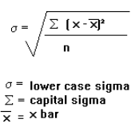
Statistics
Types:
Measure of Central Tendency(It represent central point and typical
value)
Mean(u=Ex/N)
Median
Mode
Measure of Dispersion(It is extent to which a distribution is
stretched and squeezed)
Variance Standard Deviation

Slide 6
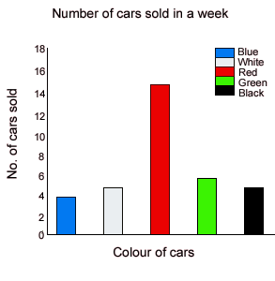
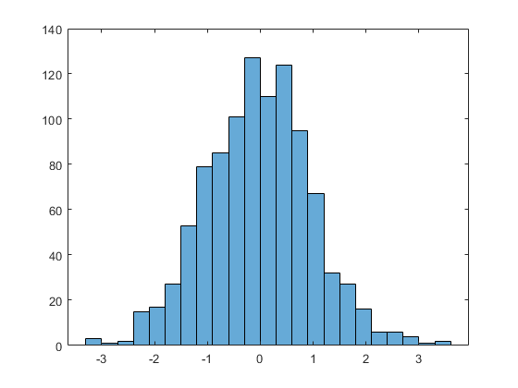
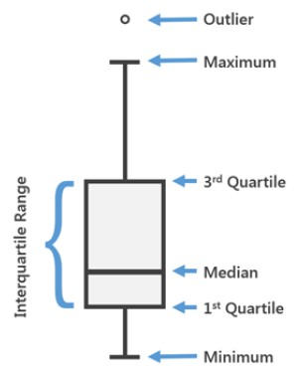
Data Visualization
Graphical models:
Bar graph
Histogram
Box plot

Slide 7
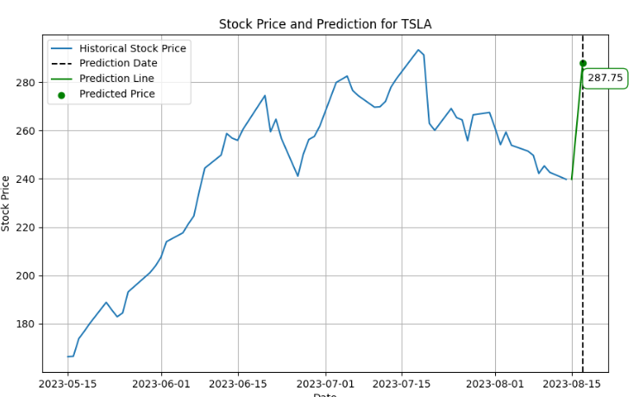
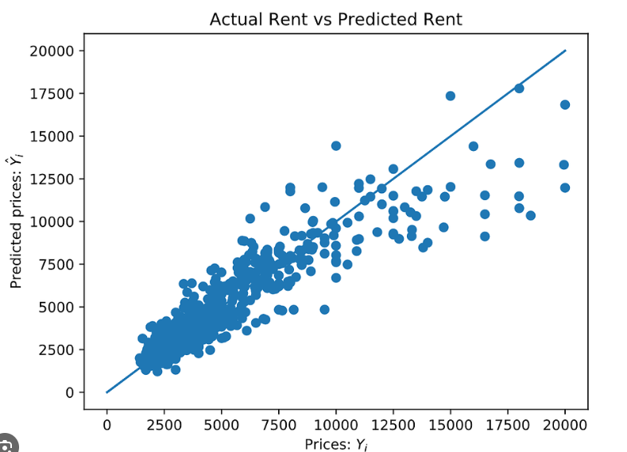
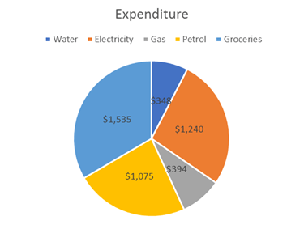
Data Visualization
Graphical models:
Line Chart
Scatter Plot
Pie Chart

Slide 8
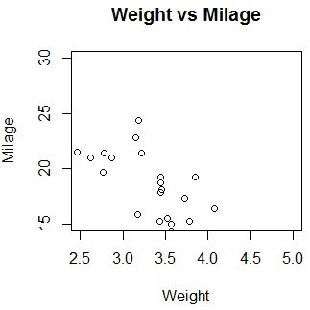
Scatter Plot

Slide 9
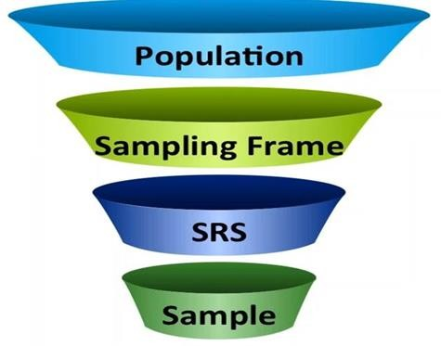
Sampling
Sampling
Population
Sample
Sample size
Sampling frame
Sampling bias
Simple random sampling

Slide 10
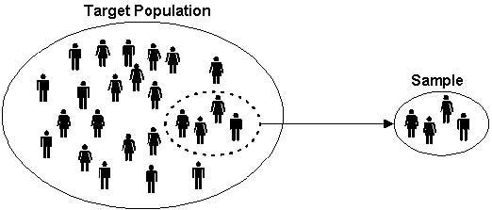
conti.
Sampling methods
Probability sampling(Probability of population element)
Non-probability sampling(No probability of population element)
Inferential Statistics

Slide 11
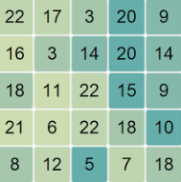
Sampling methods
Random Sampling : eg. Tossing Coin , Rolling Dice
Systematic Sampling : eg. We select every nth record
Stratified Sampling : eg. Stratum.

Slide 12
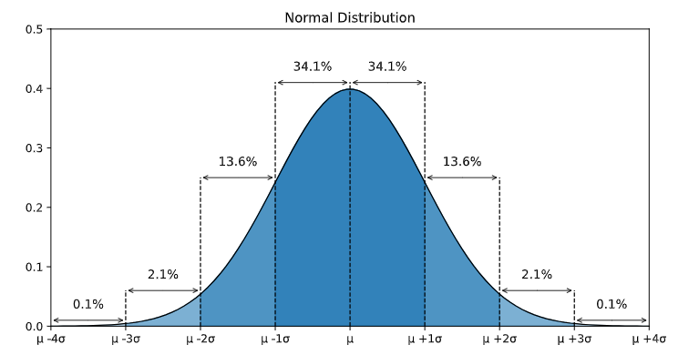
Normal Distribution / Gaussian Ditribution / Bell Curve
Standard Normal distribution

Slide 13
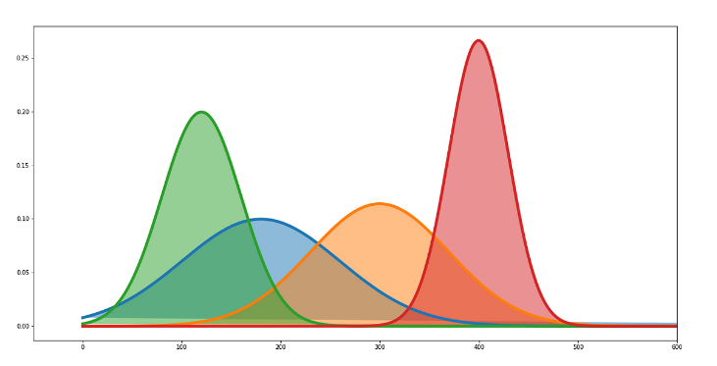
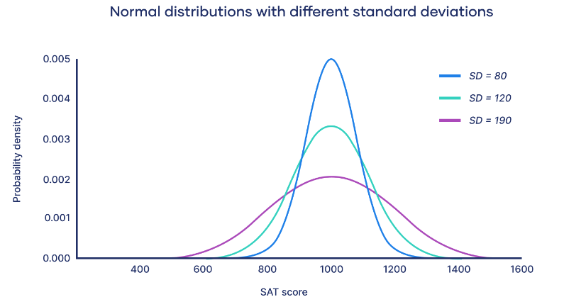
Mean is location parameter
Std deviation is scale parameter

Slide 14
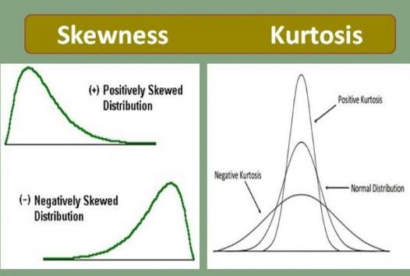
Skewness & Kurtosis

Slide 15
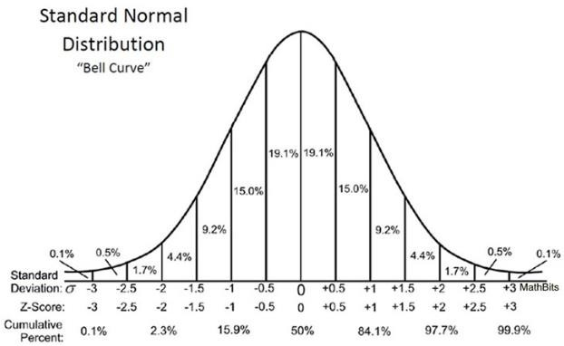
Z-Score
Converts data into frequency distribution with mean 0 and standard deviation 1.

Slide 16
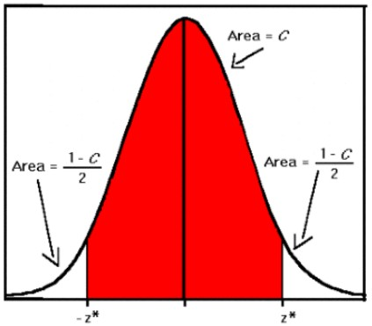
Confidence Interval
Provides the true value of an unknown parameters.

Slide 17
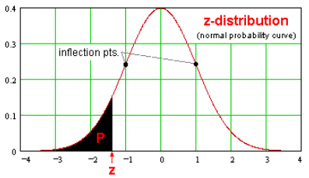
Z Distribution
Z-distribution is used to help find probabilities and
percentiles for regular normal distributions

Slide 18
T Distribution
Utilized when
Unknown standard deviation / Small sample size

Slide 19
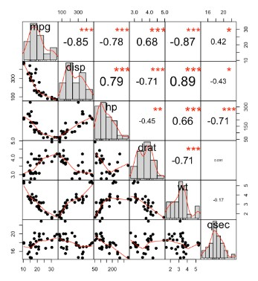
Correlation Analysis

Slide 20
Pre-program preparation
Data collection(collecting data from some source)
Data exploration and profiling(checking for incomplete)
Formatting data to make it consistent
Improve data quality(checking erroneous data)
Feature engineering(convert raw data into features)
Splitting data into training, evaluation sets
How to achieve them?

Slide 21
Pre-program preparation
Data collection(collecting data We don’t’ process the target variable , we can only make target variable as factors.
Train – Holds maximum data and used for algorithms.
Test - Holds minimum data and used for prediction.

Slide 22
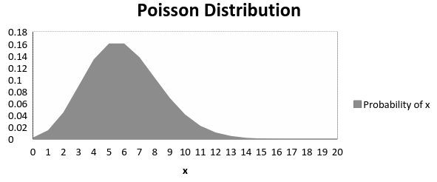
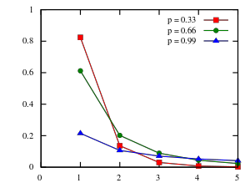
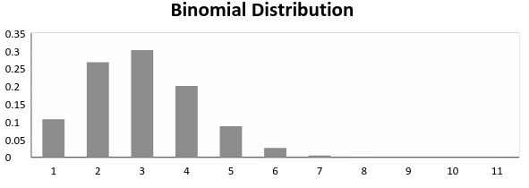
Distribution
Poisson Distribution
Logarithmic Distribution
Binomial Distribution

Slide 23
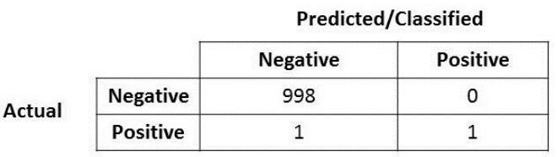



Metrics
Confusion matrix
Recall
Precision
F-Score

Slide 24
Machine Learning
Learn is the conversion of past experience into expertise or knowledge. It’s an algorithm based on technology to solve any problem.
OR
It is the field of study that gives computer, The capability to learn without being explicitly programmed.

Slide 25
Requirement of ML
Programming too complex task
Tasks performed by humans
whatever task we do in routine are not that easy to elaborate well to transform it into a program.
Tasks beyond human capacities
Highly complex task
Adaptivity
Changes in the prediction as per the change in data

Slide 26
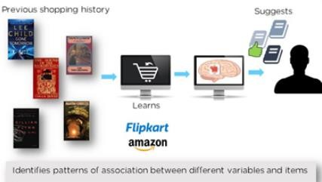
ML Example
It is a branch of artificial intelligence, focus on the design and development of algorithm that allow computers to evolve behaviours based on empirical data.
Example: The person who interested in buying a T-shirt can also buy jeans(www.amazon.in)

Slide 27
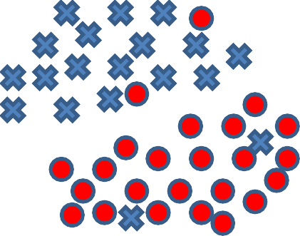
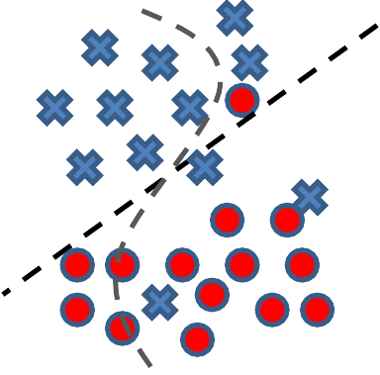











Over-fitting & under-fitting
Feature Engineering in ML
Universal set (unobserved) Appropriate fitting
Training set (observed) Overfitting
Testing set (unobserved) Underfitting

Slide 28
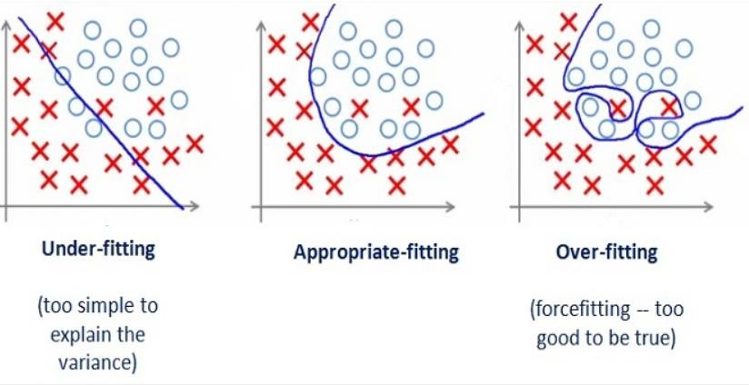
Over-fitting & Under-fitting

Slide 29
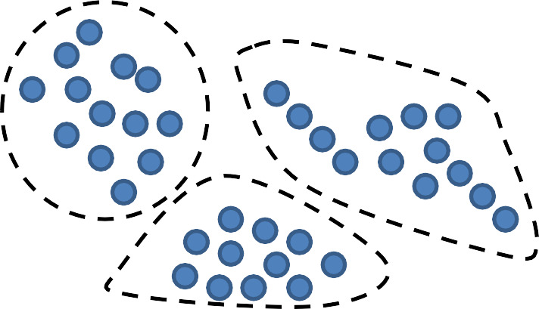
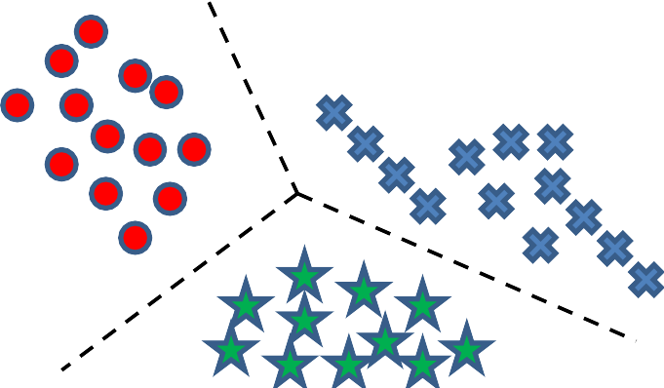
Types of learning
Supervised learning
Classification(For dataset with binary dependent variable)
Regression(For dataset with continuous dependent variable)
Unsupervised learning
Unsupervised learning
Supervised learning

Slide 30
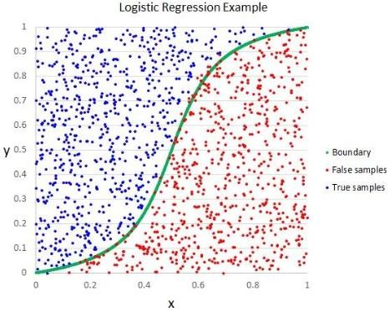
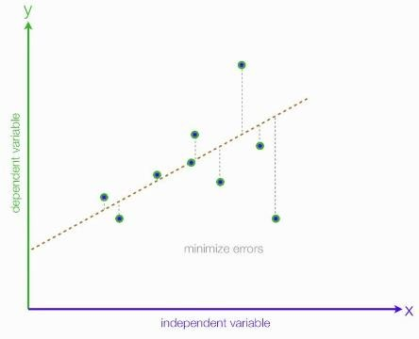
Supervised learning
Regression algorithms
Logistic regression
Regression analysis

Slide 31
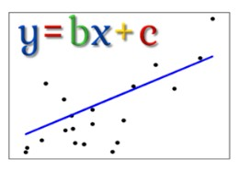
Supervised learning
Regression algorithms
Linear regression

Slide 32
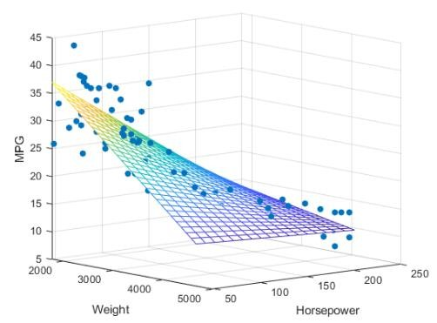
Supervised learning
Regression algorithms
Multi linear regression

Slide 33
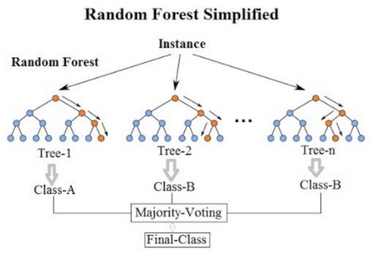
Supervised learning
Regression algorithms
Random Forest

Slide 34
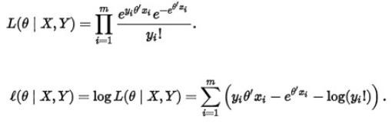
Supervised learning
Regression algorithms
Poisson regression

Slide 35
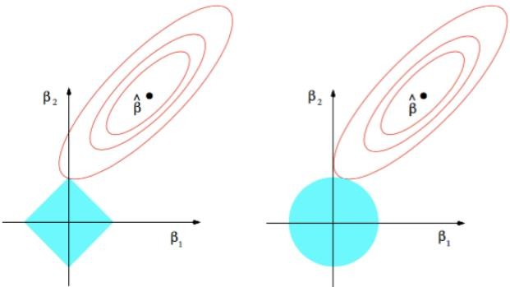
Supervised learning
Regression algorithms
Lasso and Ridge regression

Slide 36
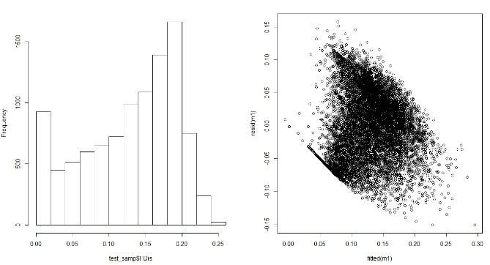
Supervised learning
Regression algorithms
Zero Inflated regression

Slide 37
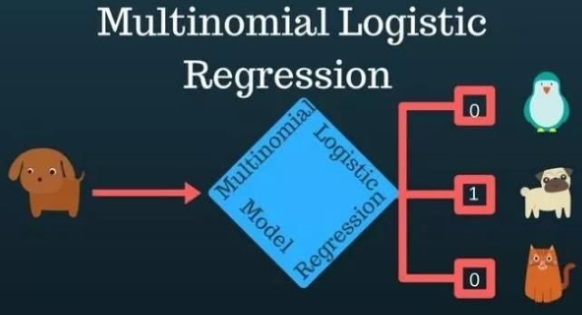
Supervised learning
Regression algorithms
Multinomial Regression

Slide 38
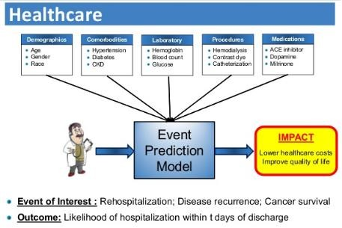
Supervised learning
Regression algorithms
Survival Analysis

Slide 39
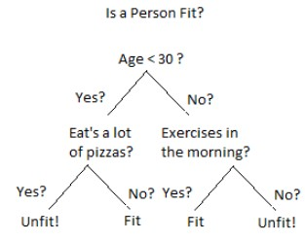
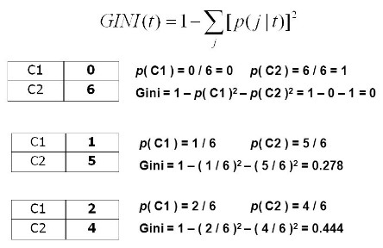
Supervised learning
Classification algorithms
Decision Tree
GINI

Slide 40
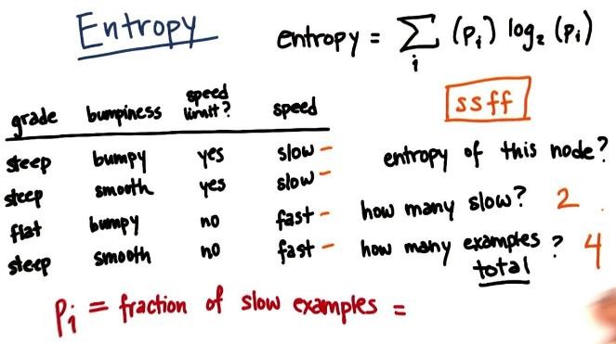
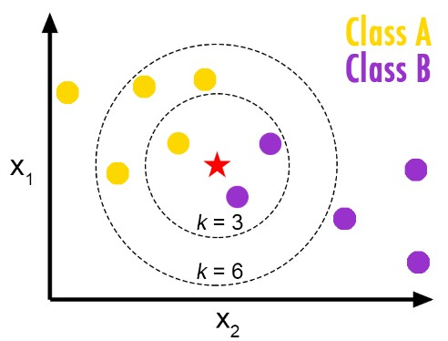
Supervised learning
Classification algorithms
Entropy
KNN

Slide 41
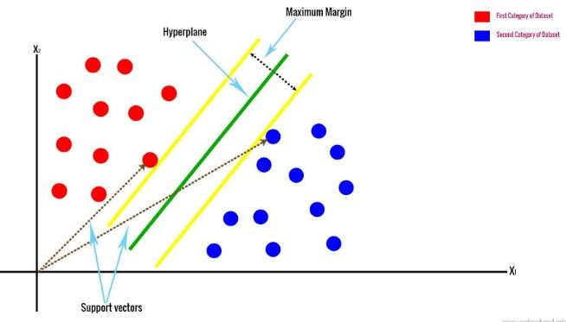
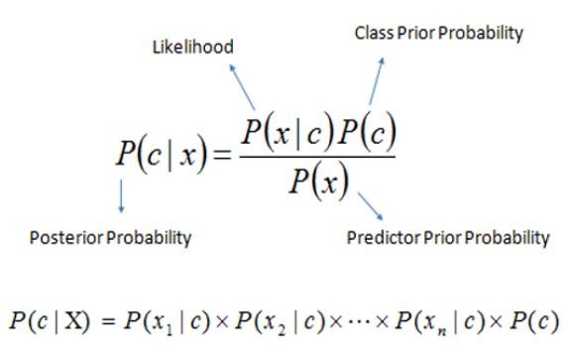
Supervised learning
Classification algorithms
SVM
Linear Naïve classifier
classifier:
Bayes

Slide 42
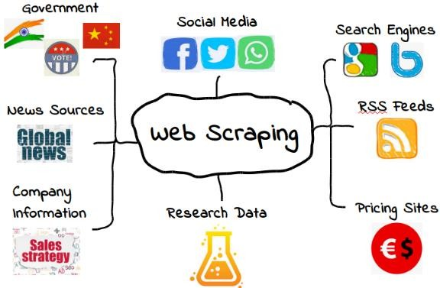
Web Scrapping
Web Extraction

Slide 43
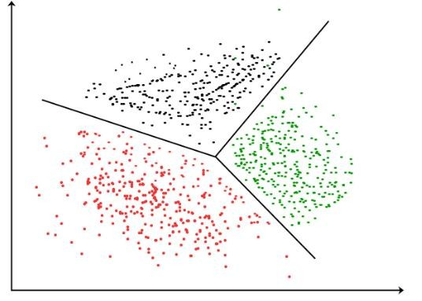
Unsupervised learning
Introduction to Clustering
This learning strategy is
use for whose target missing.
the problem dependent/ variable is

Slide 44
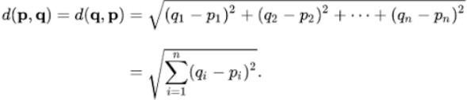
Unsupervised learning
Euclidean distance

Slide 45

Unsupervised learning
Hierarchical clustering

Slide 46

Unsupervised learning

Slide 47


Unsupervised learning
Manhattan Distance
K-Medoid
clustering

Slide 48

Unsupervised learning
DBSCAN

Slide 49

Unsupervised learning

Slide 50

Dimension Reduction
Reduction of number of random variables.

Slide 51

PCA

Slide 52

Word Cloud
Novelty visual representation of text data

Slide 53
Topics
Numpy
>>>import numpy as np
>>>np.sum([1,2,34,5,6,7,8])
Pandas(Library for data manipulation and analysis)
Matplotlib(Library for making graphical display)

Slide 54
Data preprocessing
Data collection(collection from source)
>>>import pandas as pd
>>>df=pd.read_excel(open(‘fileName.xlsx’,’rb’))
>>>x=df.iloc[:,:-1]
>>>y=df.iloc[:,-1]
Imputer and Dropna(filling missing value or dropping the tuples)
>>>from sklearn.preprocessing import Imputer
>>>imp=Imputer()
>>>array=imp.fit_transform(array)
Label encoder(converting strings into labels)
>>>from sklearn.preprocessing import LabelEncoder
>>>lbl=LabelEncoder()
>>>array=lbl.fit_transform(array)

Slide 55
Data preprocessing
One hot encoder(making dummies variables)
>>>from sklearn.preprocessing import OneHotEncoder
>>>ohe=OneHotEncoder(categorical_features=[attribute no])
>>>array=ohe.fit_transform(array)
Standard scaler(Normalizing data)
>>>from sklearn.preprocessing import StandardScaler
>>>sc=StandardScaler()
>>>array=sc.fit_transform(array)
Train test split(splitting data into training and testing set)
>>>from sklearn.model_validation import train_test_split
>>>res=train_test_split(input, output, test_size=0.20)

Slide 56
Supervised learning
Regression algorithms
Logistic regression
Regression analysis

Slide 57
Supervised learning
Regression algorithms
Linear regression

Slide 58
Unsupervised learning
Hierarchical clustering

Slide 59
Unsupervised learning

Slide 60
NLP

Slide 61

Introduction to NLP

Slide 62

Libraries and modules
Download
Import using python tool and download rest packages
>>>import nltk
>>>nltk.download()

Slide 63

Text mining
It is the process of extracting important information from a natural text. It is unstructured, amorphous and difficult to deal with algorithmically.
Goal: turn the text into data for analysis using natural language processing.

Slide 64

Application of text mining
Sentimental analysis(Positive, negative, neutral views)

Slide 65

Application of text mining
Chat-bot(chatting with a robot)

Slide 66

Application of text mining
Speech recognition(speech to understandable text)

Slide 67

Application of text mining
Machine translation(Google translator)

Slide 68

Application of text mining
Information extraction(from website or document)

Slide 69

Application of text mining
Advertising machine(recommendation of adds as per your history)

Slide 70

Text mining process
Tokenization
Covert a string into small tokens.
Library to import nltk.tokenize.word_tokenize

Slide 71

Text mining process
Stemming
PORTERSTEMMER
LANCASTERSTEMMER

Slide 72
Text mining process
Lemmanization
It produces a proper word using POS tags.

Slide 73

Text mining process
Parts of speech

Slide 74

Text mining process
Name entity recognition

Slide 75

Text mining process
Chunking
Implementation using a case study

Slide 76
Deep learning

Slide 77

Introduction
Today’s real time problems have high dimensions, so they are very complex to handle and process. Like image data. ML is not capable of solving these use-case so deep learning came for rescue.

Slide 78
Applications
Future predictions – eg. based on past data
Stock Market
Banking – eg. loan prediction
Sequence detection – eg. barcode etc
Complexity Modelling

Slide 79

Working
Deep Learning uses a Neural Network to imitate animal intelligence.

Slide 80

Neural network
Works like a human brain to process an information
Types:
ANN
CNN
RNN

Slide 81

Working Flow

Slide 82

Working of NN
NON NN part
NN part

Slide 83



Components of NN
Layers
INPUT
HIDDEN
OUTPUT
Activation function
Unit function
Relu
Leaky Relu
TanH
Sigmoid
Linear
Softmax

Slide 84

Components of NN

Slide 85

Introduction to Tensorflow
It is developed by google brain team of google in 2015 for computation purpose. Uses to make the algorithm fast.

Slide 86

Introduction to Theano
It is developed by LISA(now MILA) group at the university of Montreal, Quebec, Canada (home of Yoshua Bengio)

Slide 87

ANN
For classification problem
Case study

Slide 88

ANN
For regression problem
Case study

Slide 89

RNN
LSTM
It solves the problems in which sequence of the data matters as such problem is not possible to solve through ANN.

Slide 90
ANN vs RNN
ANN
No effect on changing
sequence of data.
No memory elements are there.
Utilize for non order
data
Less complex then RNN
RNN
Changing sequence
effect results.
Memory element use to predict the next state.
Utilize for video, text,
image etc.
More complex than ANN

